Slide 1


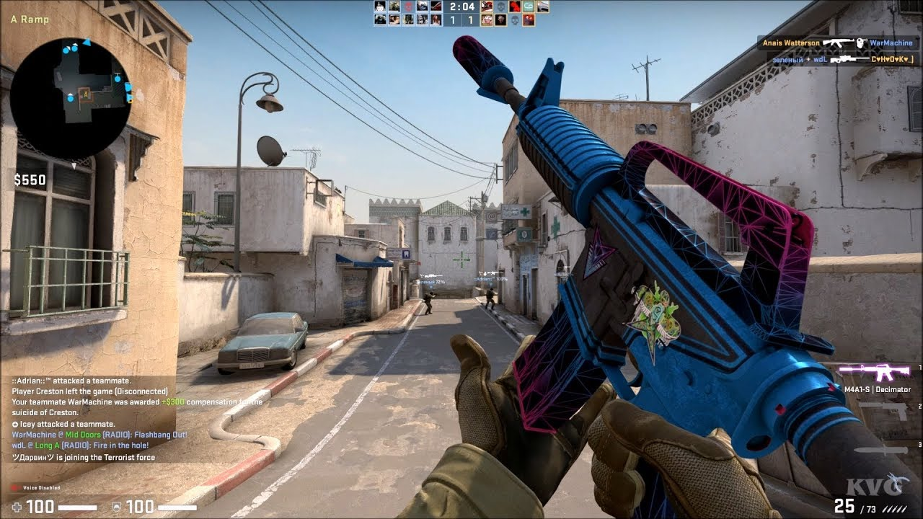

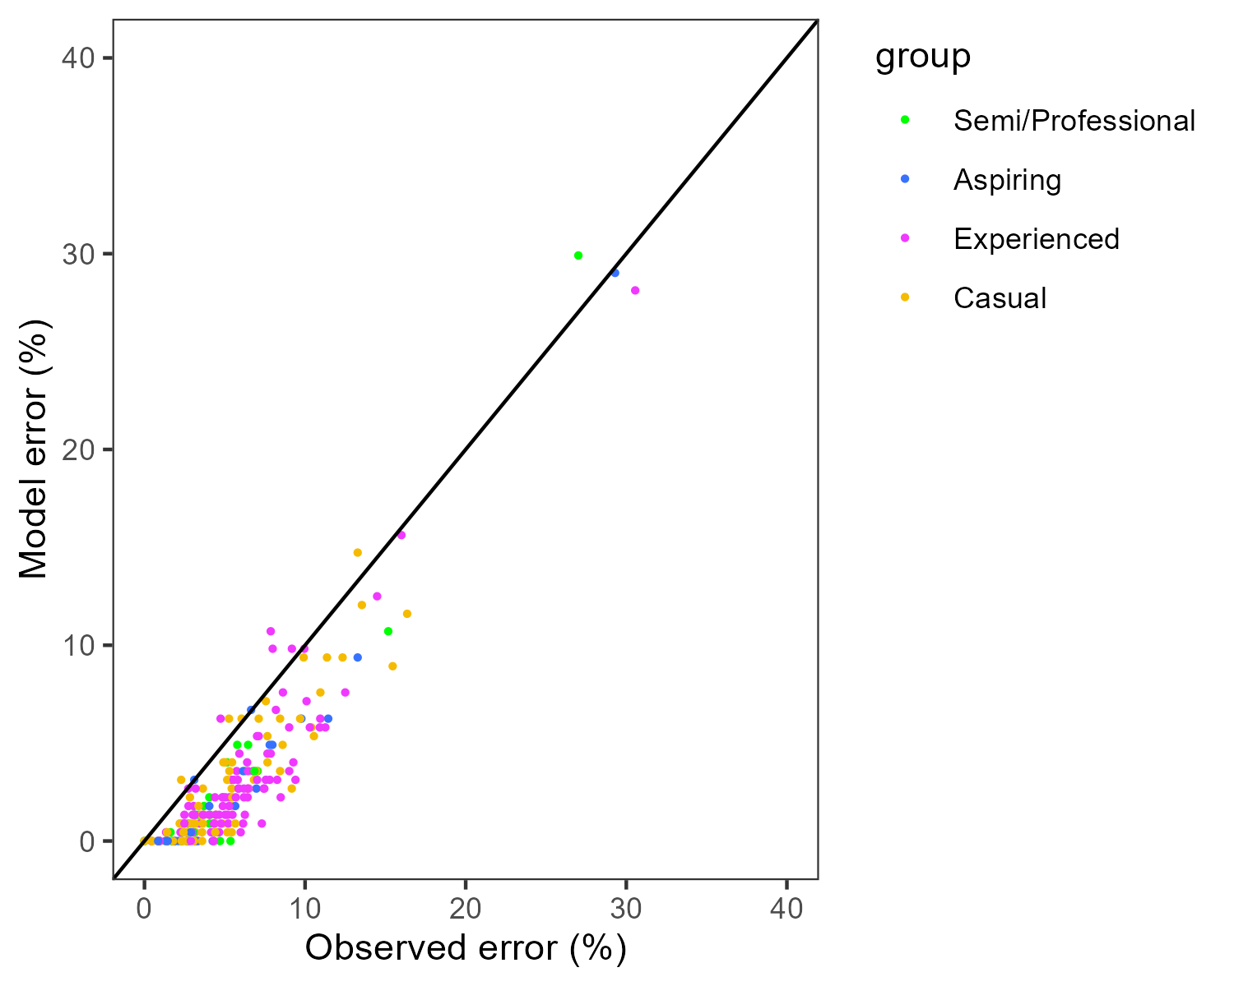
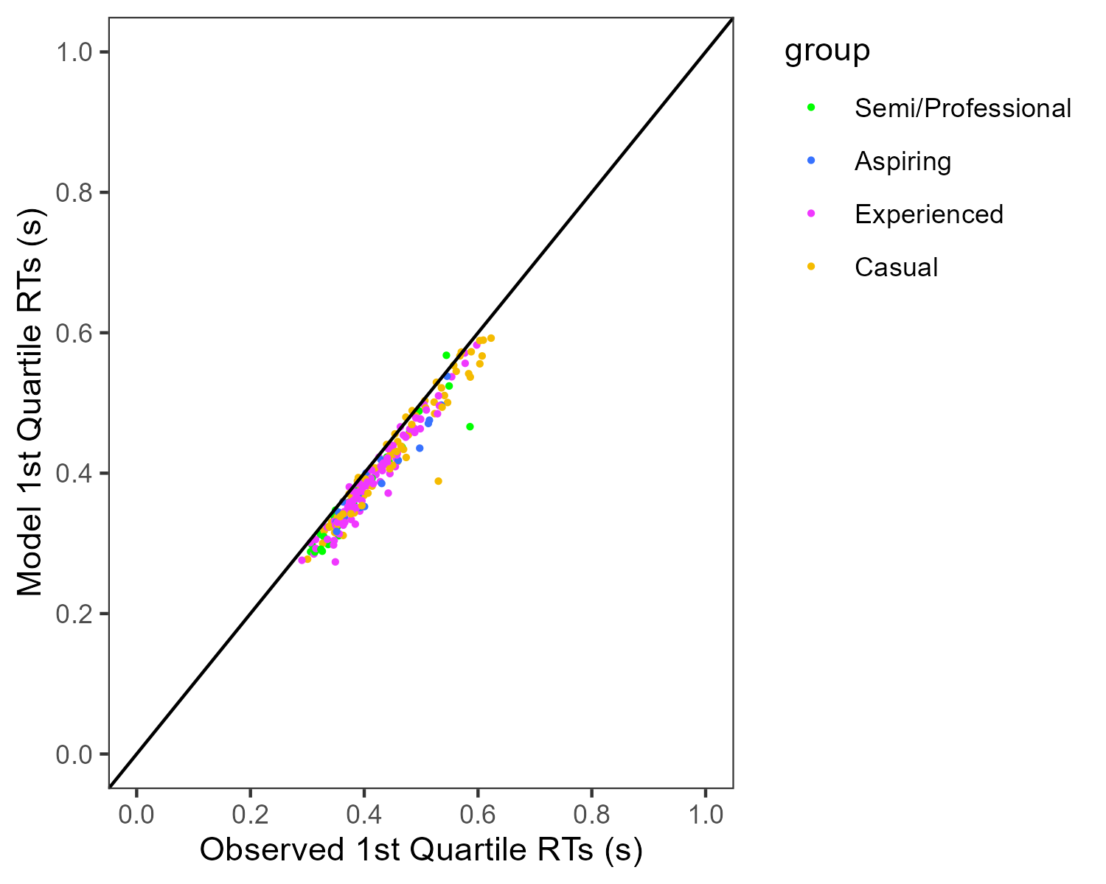
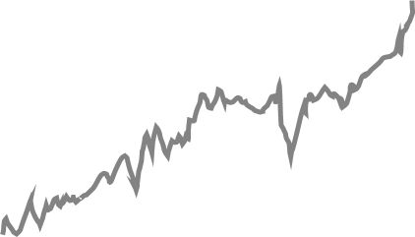
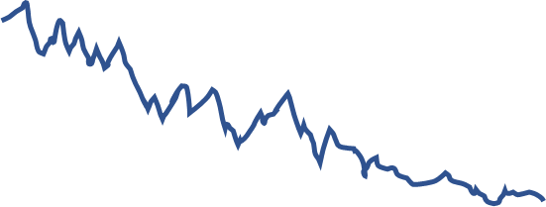
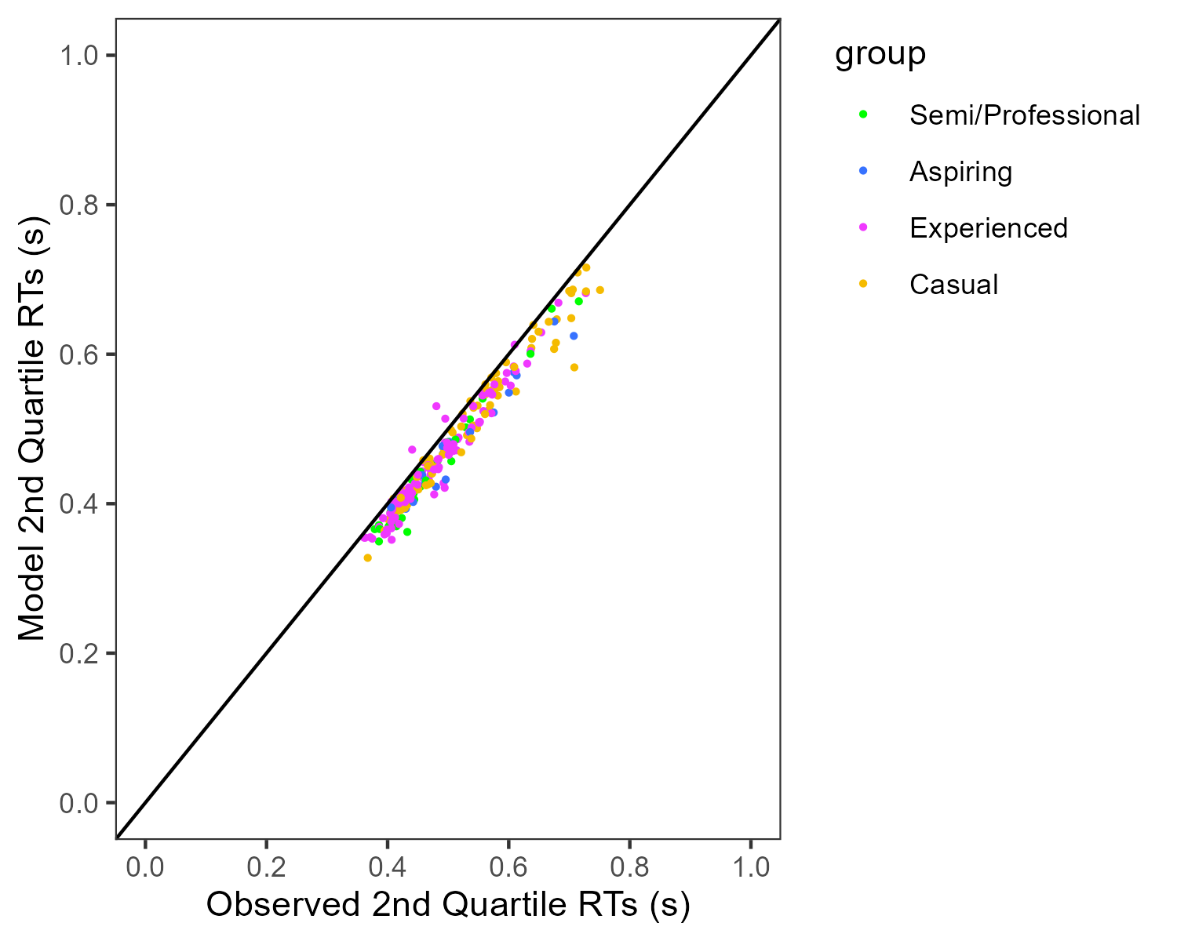
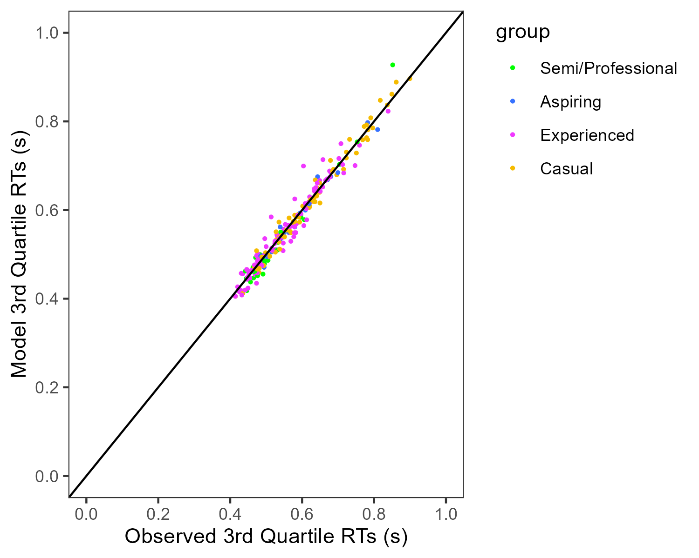

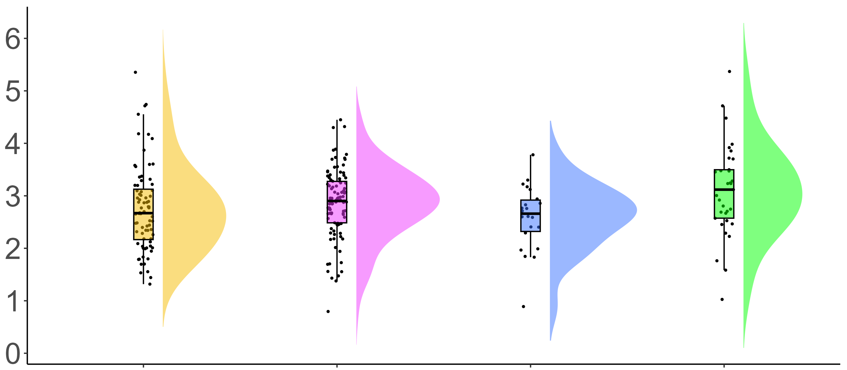
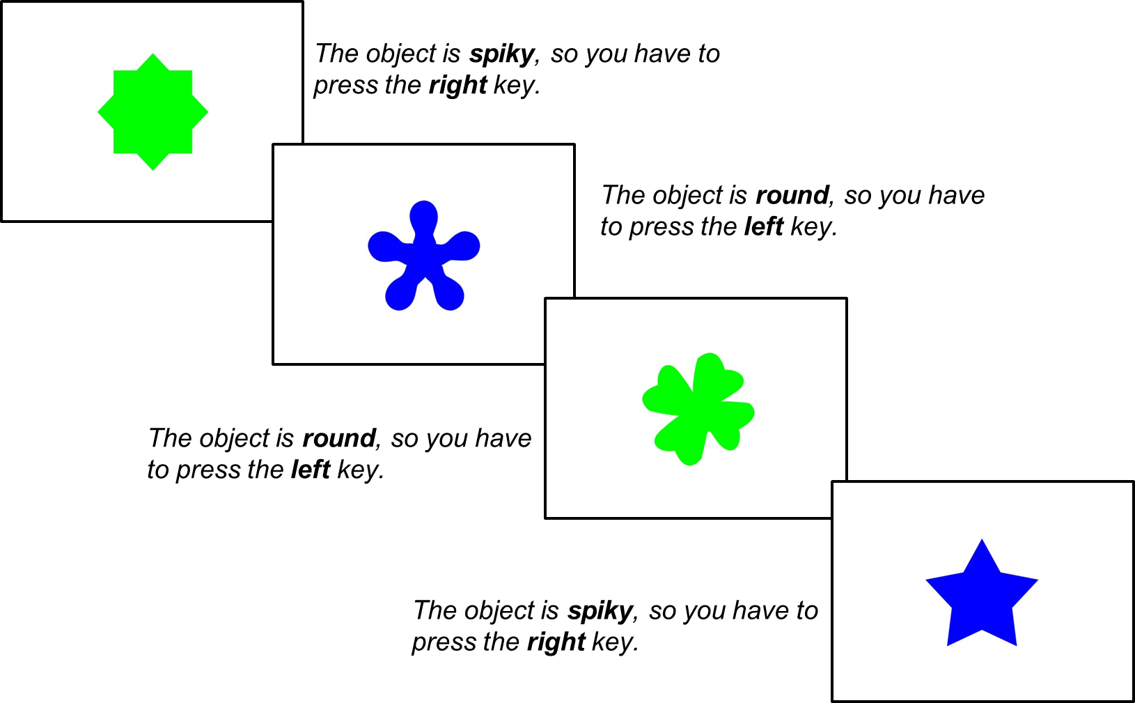

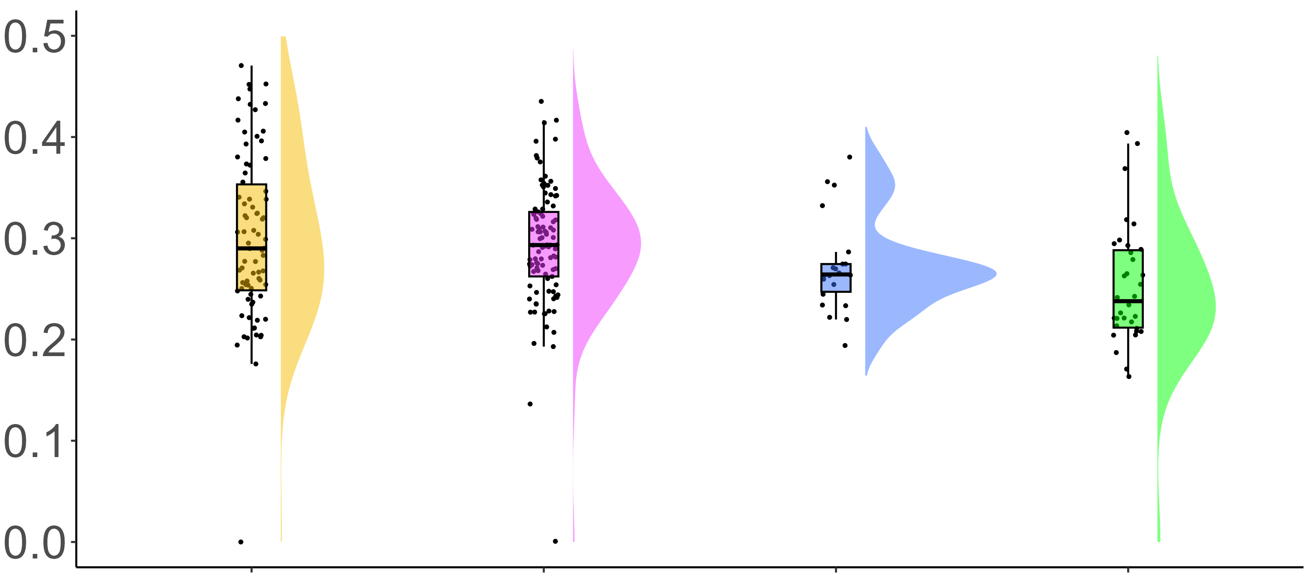
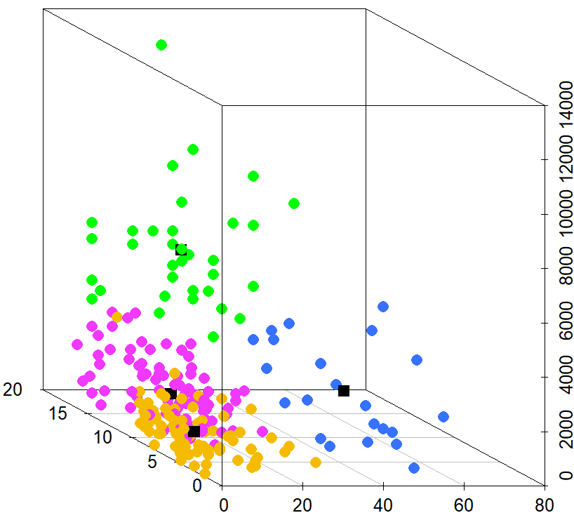
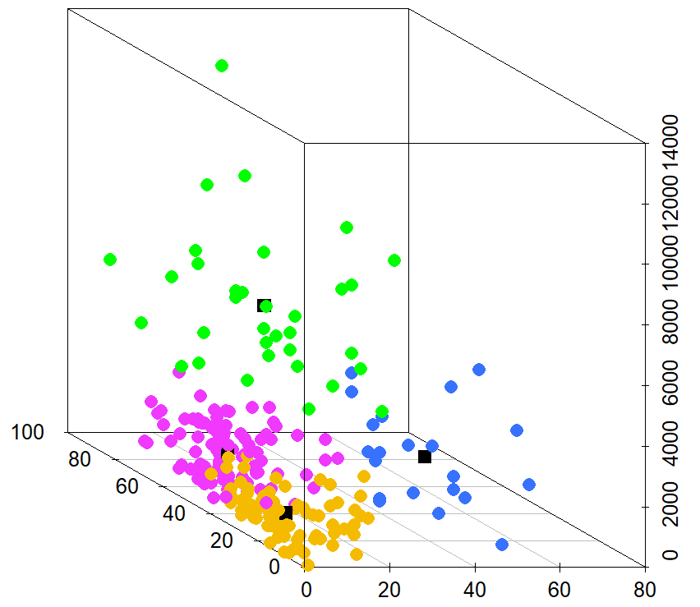
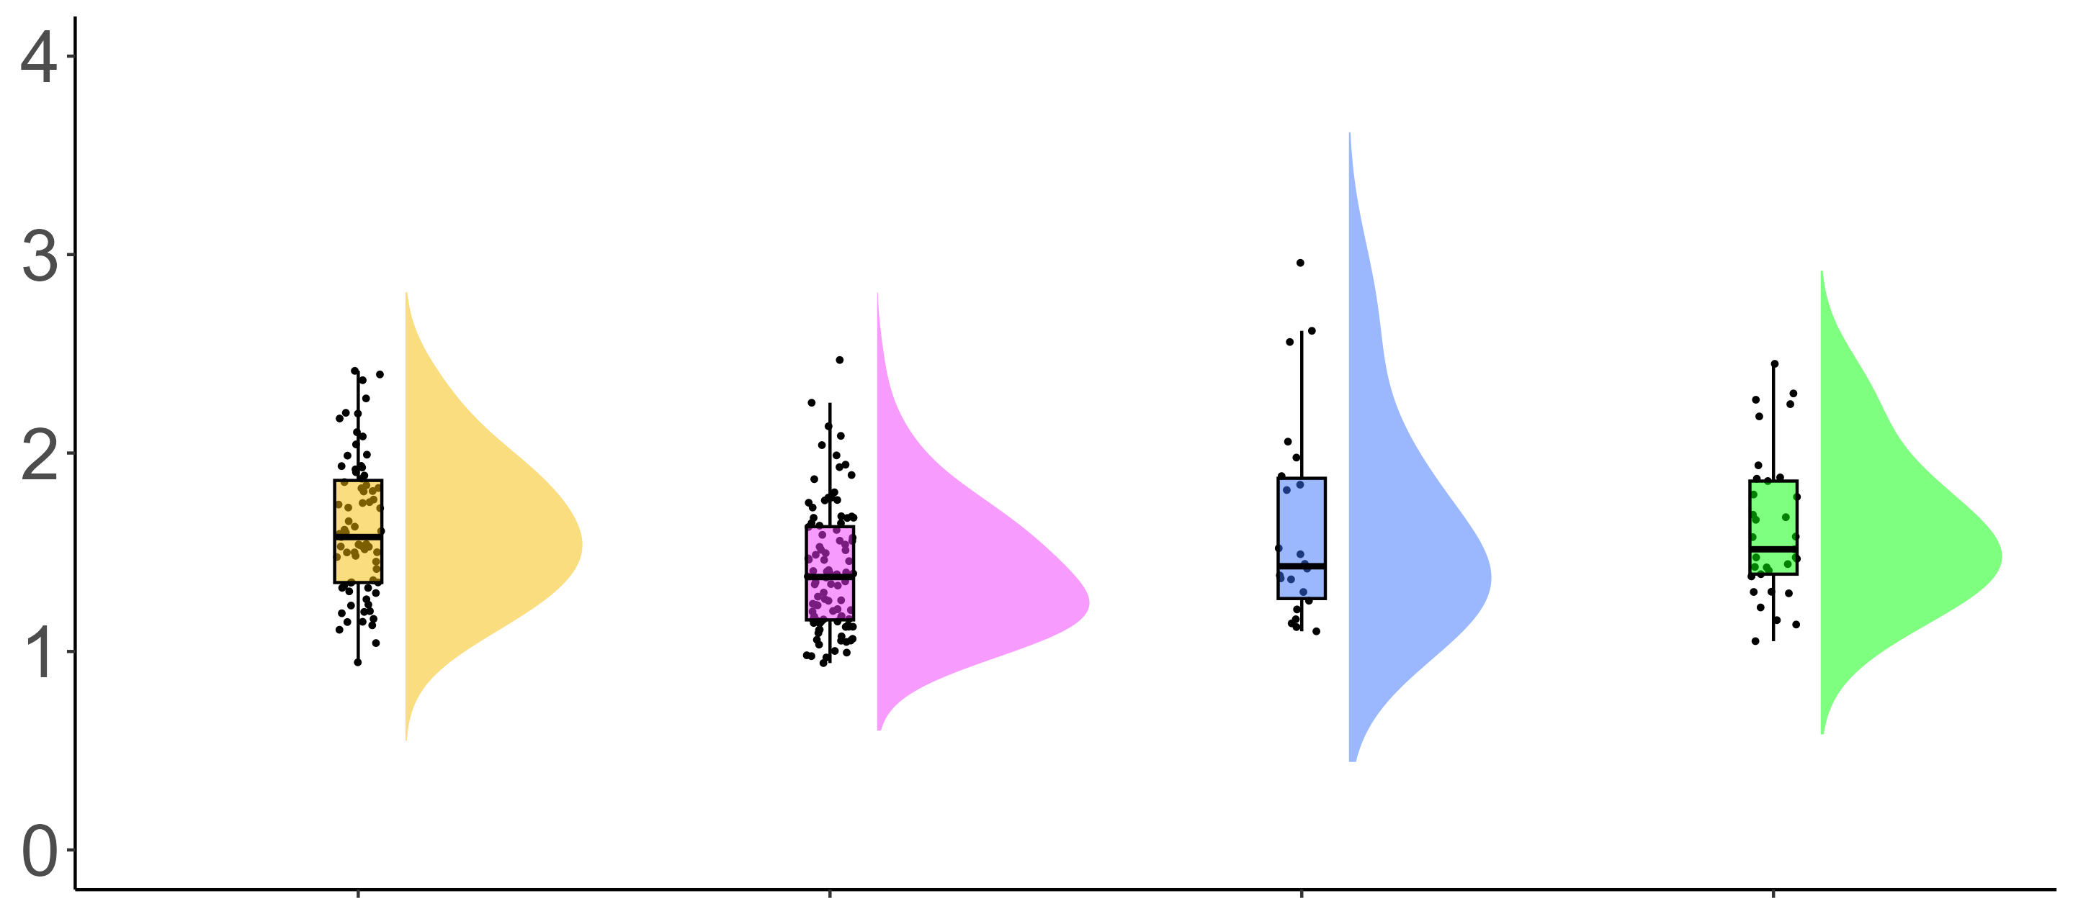
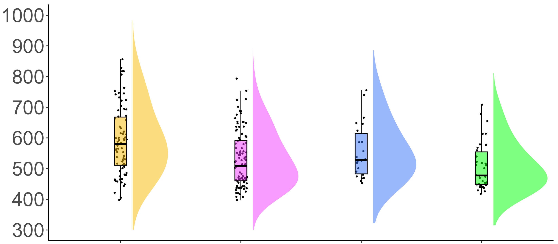
COGNITIVE CORRELATES OF FIRST-PERSON SHOOTER GAMING: A CROSS-SECTIONAL STUDY OF COUNTER-STRIKE PLAYERS
Eleanor R. A. Hyde, Robert Schmidt, Daniel J. Carroll, & Claudia C. von Bastian
erahyde1@sheffield.ac.uk eleanorhyde.com @era_hyde
BACKGROUND
Research shows an inconsistent association between FPS play and processing speed1, 2.
By decomposing reaction times (RTs) using the drift-diffusion model (DDM)3, researchers found FPS training to improve drift rates4, whilst others found FPS training to increase boundary separations2. These mixed findings may be due to methodological limitations such as small samples, broad definitions of AVGs.
DRIFT-DIFFUSION MODELLING
First-person shooter (FPS) games are fast-paced, dynamic video games which require quick decision-making.
Correct response
Starting point
Boundary Separation
Drift rate
Incorrect response
RESEARCH QUESTIONS
How should Counter-Strike: Global Offensive (CS:GO) expertise be measured?
Is greater CS:GO expertise associated with faster processing speed?
Do the decision processes underlying processing speed differ with CS:GO expertise?
Stimulus encoding
Decision time
Response execution
F(3,231) = [2.13], p = .098
Drift rate (ν)
METHOD
Choice RT Task CS:GO Expertise
Questionnaire
M = 2.86, SD = 1.07
M = 2.90, SD = 0.77
M = 2.59, SD = 0.62
M = 3.20, SD = 1.05
Total hours playtime
Weekly hours playtime
Self-rated expertise
Current ranking
F(3,231) = [5.37], p > .001
Non-decision time (t0)
K-MEANS CLUSTERING
Casual N = 78 Experienced N = 101 Aspiring N = 22 Semi/Professional N = 34
M = 0.30, SD = 0.08
M = 0.29, SD = 0.06
M = 0.27, SD = 0.05
M = 0.25, SD = 0.07
F(3,231) = [1.81], p = .150
Total hours playtime
Total hours playtime
Boundary separation (α)
Current ranking
Weekly hours playtime
Self-rated expertise
Weekly hours playtime
M = 1.78, SD = 0.90
M = 1.50, SD = 0.91
M = 1.64, SD = 0.52
M = 1.85, SD = 1.34
Casual
Experienced
Aspiring
Semi/Professional
PROCESSING SPEED
Group
F(3,231) = [7.52], p > .001
RESULTS
Clustering is a viable method of identifying expertise groups in CS:GO players.
High expertise CS:GO players demonstrate faster processing speed in terms of faster RTs in a Choice RT task, with no differences in accuracy.
DDM suggests that RT differences were mainly due to faster non-decision times (t0).
Reaction Time (ms)
M = 591, SD = 112
M = 530, SD = 91
M = 556, SD = 89
M = 508, SD = 77
TAKE HOME MESSAGE
FPS expertise is a multi-dimensional construct that should be captured by a range of measures.
Highly expert FPS players show advantages in processing speed, encoding and response execution – showing transfer from a video game to a cognitive task.
Casual
Experienced
Aspiring
Semi/Professional
Group
REFERENCES
VALANDASKLDLKASDMSA;LKDSA
AKDKSAD;KSAD
SKADASKL;DMNSA
ASDNKLASNDKLSANDKLA

